Slide 1
The Church Elder And The Pulpit
Mario Thorp
New Jersey Conference

Slide 3
SDA Church Manual pg 34 Credentials and Licenses
No one should be allowed to speak to any congregation unless he/she has been invited by the church in harmony with guidelines given by the conference. It is recognized, however, that there are times when congregations may be addressed by government officials or civic leaders; but all unauthorized persons shall not be given access to the pulpit. (See pp. 118-121.)

Slide 4
SDA Church Manual Pulpit Not a Forum pg 118
The Church confers no right to any pastor, elder, or other person to make the pulpit a forum for advocating disputed points of doctrine or church procedure.

Slide 6
2 Timothy 4:1-2 New King James Version (NKJV)
I charge you therefore before God and the Lord Jesus Christ, who will judge the living and the dead at His appearing and His kingdom: ² Preach the word! Be ready in season and out of season.
Convince, rebuke, exhort, with all longsuffering and teaching.

Slide 7
2 Timothy 4:2
Message (MSG)
He is about to break into the open with his rule, so proclaim the Message with intensity; keep on your watch. Challenge, warn, and urge your people. Don’t ever quit. Just keep it simple.

Slide 8
2 Timothy 4:2
Living Bible (TLB)
² to preach the Word of God urgently at all times, whenever you get the chance, in season and out, when it is convenient and when it is not. Correct and rebuke your people when they need it, encourage them to do right, and all the time be feeding them patiently with God’s Word.

Slide 9
2 Timothy 4:2
International Standard Version
to proclaim the message. Be ready to do this whether or not the time is convenient. Refute, warn, and encourage with the utmost patience when you teach.
New Heart English Bible
proclaim the word; be urgent in season and out of season; reprove, rebuke, and exhort, with all patience and teaching.
Contemporary English Version
to preach God's message. Do it willingly, even if it isn't the popular thing to do. You must correct people and point out their sins. But also cheer them up, and when you instruct them, always be patient

Slide 10
Sense a Deep Respect for the Pulpit

Slide 11
Do Not Use the Pulpit:
To entertain the attendees.
In order to achieve personal exaltation.
Only to fill a space of time within a schedule.
With the intention of hurting and hitting the brothers.

Slide 12
To tell jokes or stories just to make people laugh
In order to prove their views or their personal theories.
In order to prove that he is the best preacher of the church.
To exalt the enemy more than Jesus.

Slide 13
To destroy the little faith of the sinner.
In such a way that it generates divisions in the church.
In order to generate controversies that almost never lead to good conclusions.
If you are not sure of the divine approval.

Slide 14
In such a way that it confuses the minds of the assistants.
Without due material and spiritual preparation.
Without first having devoted time to prayer.
If you are not sure to carry a message of hope.

Slide 15
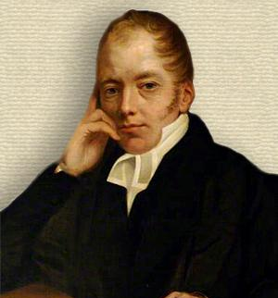
"Never preach because you have to say something, but because you have something to say." (Richard Whately)

Slide 16
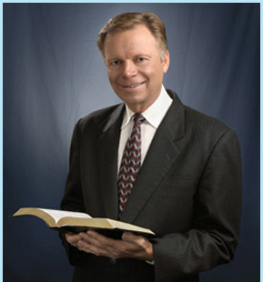
"God has not promised to bless our arguments, but his word." Mark Finley

Slide 17
Be simple or profound, but be clear.

Slide 18
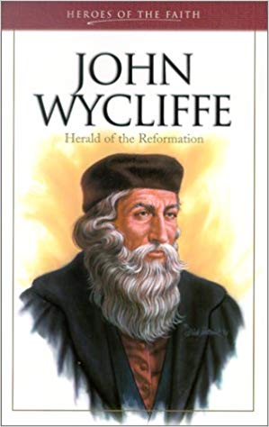
Holy Scripture is the highest authority for every believer, the standard of faith and the foundation for reform. John Wycliffe
However deep or simple the topic may be, try to make it clear, understandable and that people identify the message they want to teach
Remember that a good illustration helps you to better understand and record or remember the lessons.

Slide 19
“The highest service to which a man may obtain on earth is to preach the law of God.”
— John Wycliffe

Slide 20
If there is something that is not clear to you, better clarify it before preaching it.
Be sure that people will understand the message.
Use simple language, according to the kind of audience you are in.

Slide 21
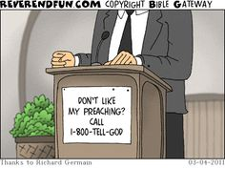
Be sure that the terms you are using, people are understanding.
Do not invent strange phrases that you yourself do not know what they mean.
Nor confuse a simple language with any language.
Learn about Jesus as the best preacher of all time.

Slide 22
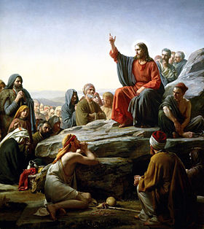
"Elders and young people, ignorant and wise, could all understand the full meaning of their words."
Councils for Teachers page 227

Slide 23
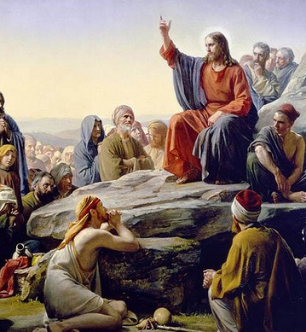
"... and the common people listened to him gladly, because they could understand his words. HE DID NOT USE ALTISONANT WORDS, for whose understanding it would have been necessary to consult a dictionary. "
Council for Teachers, page 228.

Slide 24
Be careful with the tone of your voice

Slide 25
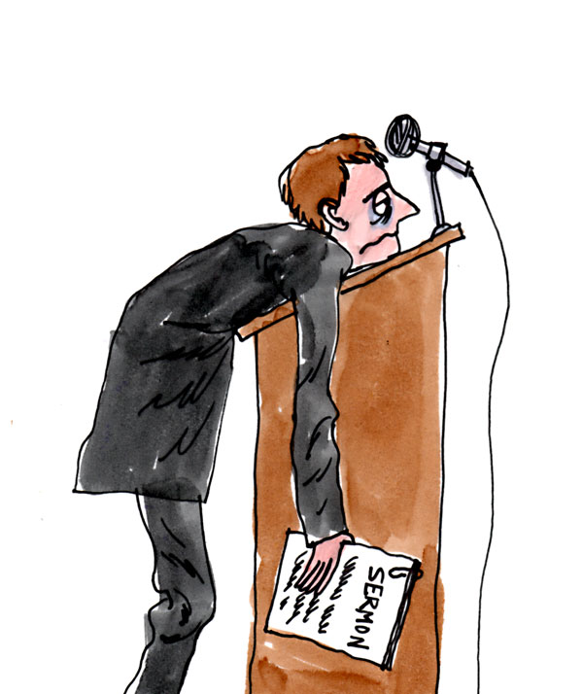
Do not get accustom to using a tone too muted, subdued, hushed, that people find it hard to hear and become monotonous.
Do not get accustom to screaming in such a way that people find it hard to concentrate and listen to you.

Slide 26
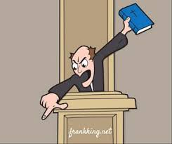
Allow the tone of the voice to reflect the kind of message you are sharing.
Do not forget that the best formula is to vary the tone of the voice frequently.
Do not talk so fast that people find it hard to follow and understand it.

Slide 27
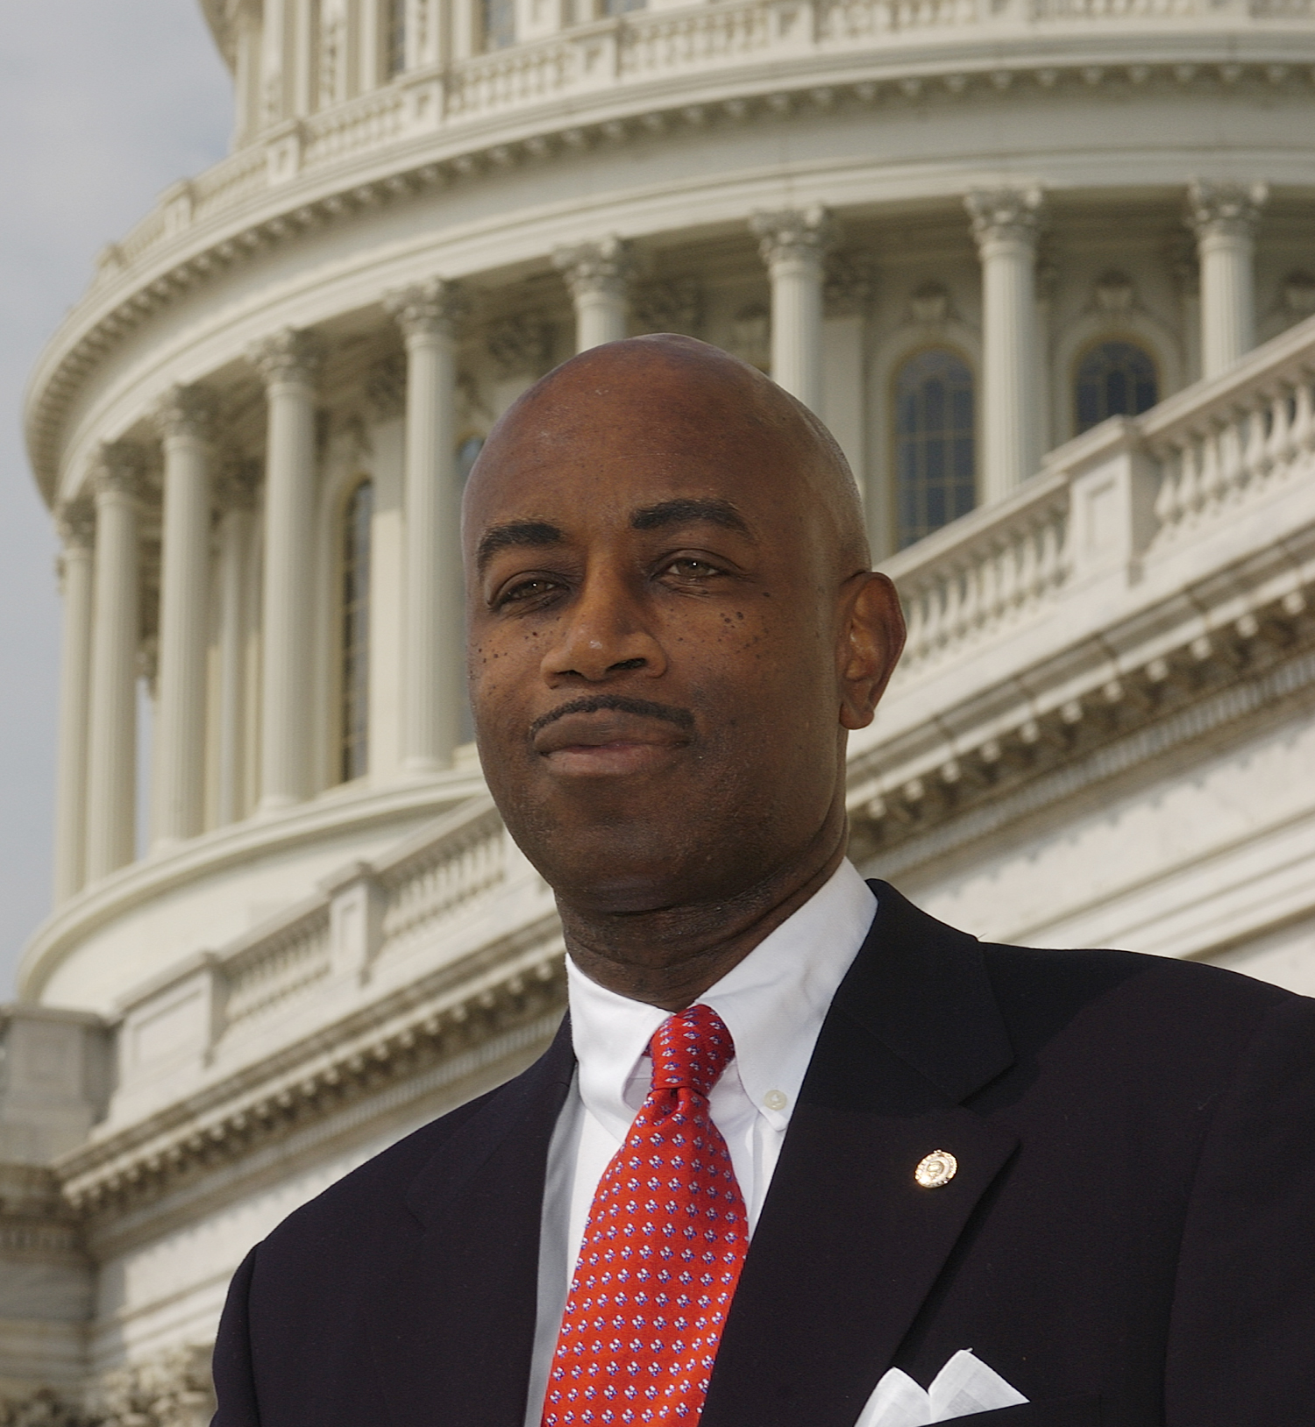
“My identity is rooted in who I am in Christ…” Barry Black
Try to pronounce the words well so that people can clearly understand everything you say.
Do not lower the volume of your voice at the end of the words in such a way that the sentences sound cut.
Let your words and gestures be in harmony.

Slide 28
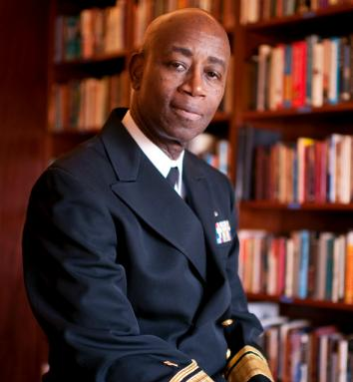
My identity is not rooted in what my job title may be, because a job can change. My identity is rooted in who I am in Christ. And I see myself as the apostle Paul puts it in 1 Corinthians 4:1, as a servant of Christ and a steward of His mysteries. So I think that whether I'm in the Senate, the Navy Chaplaincy, or in a congregational setting, it really doesn't matter. I believe that He requires, as Paul says, that servants and stewards be found faithful.“ Barry Black

Slide 29
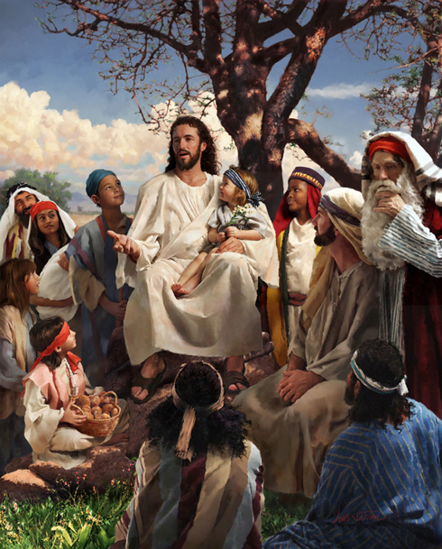
"The voice of Jesus was like music to the ears of those who had been accustomed to the monotonous and lifeless preaching of the scribes and Pharisees."
Councils for Teachers, page 227

Slide 30
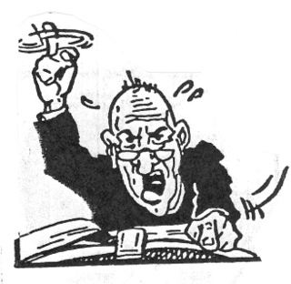
“Many speak quickly and in a HIGH tone that is not natural. "
Councils for Teachers, page 227

Slide 31
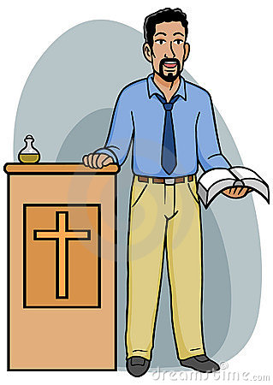
Do not become monotonous and repetitive

Slide 32
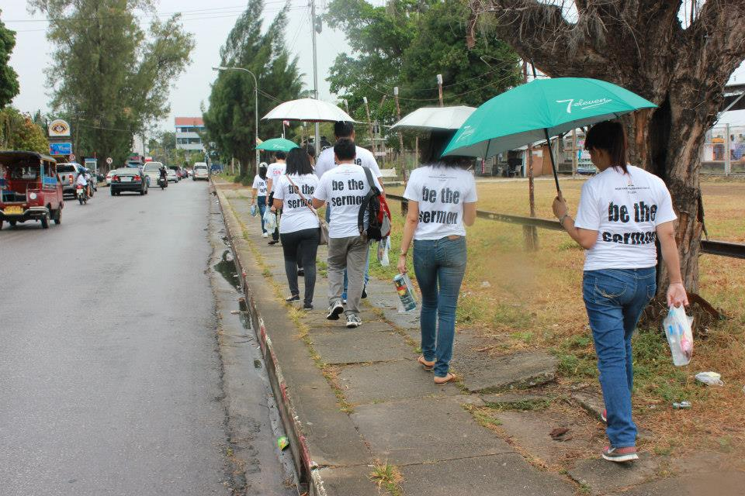
Live the message you are preaching and make people live the message with you. Achieve the above but without falling into exaggerations, without reaching extremes. Avoid that the preaching becomes a show, in a show, full of gestures, gestures and sudden and exaggerated movements.

Slide 33
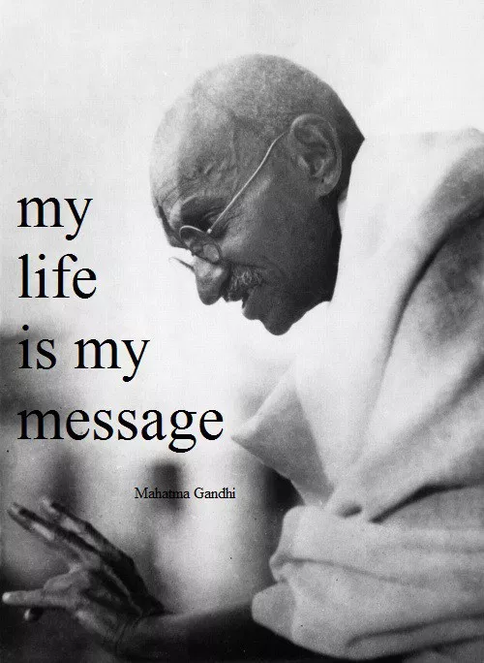

Slide 34
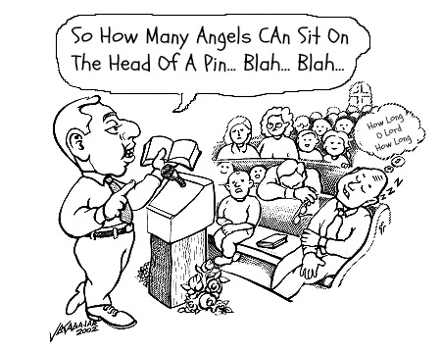
????
Do not become repetitive, giving the impression that you have nothing more to say and you are revolving around the same idea already explained.
Do not abuse the listeners by being very extensive in such a way that the essence of the message is lost.
Remember that there are elders and children in the auditorium.

Slide 35
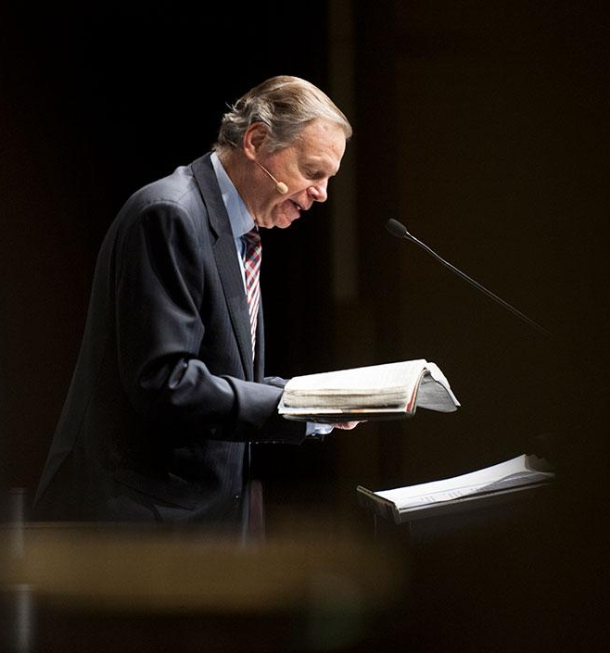
Always maintain the posture of a man who is being used by God.
Try to remind people of the message rather than the messenger.
Know how to use your hands correctly.
Beware of the crickets as they can affect the understanding of the message.

Slide 36
The Man Behind the Message – CD Brooks Hope is seeing light in spite of being surrounded by darkness.
If possible, do not turn your back on the congregation.
If you are going to tell a story, do not make a show in the pulpit in such a way that the story becomes a joke.

Slide 37
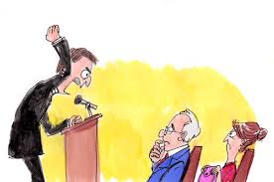
"He who works for God must make earnest efforts to become a representative of Christ, discarding all inconvenient GESTURES and rough language.
He should strive to use correct language.“
Councils for Teachers, page 226

Slide 38
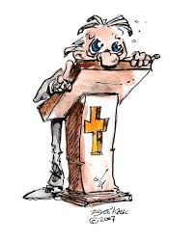
Worry about pronouncing the words well. A mispronounced phrase not only disdains you as a preacher, but will cause deconcentrating of the listeners.

Slide 39
Divide your theme correctly

Slide 40
Do not present the subject as one piece; this makes learning difficult.
Divide the topic into several topics that allow you to extract the most important lessons.

Slide 41
Try to emphasize each of the lessons you want to highlight.
At the end of the topic try to highlight the most important lessons.

Slide 42
Do not overdo the number of topics or subdivisions.
Between four or five is enough Remember that a seminar is different from a sermon.

Slide 43
In a seminar you can have many more divisions than in a normal sermon.

Slide 44
The effectiveness of the subject does not depend on the amount of material that you expose.
If the amount of material exposed is exaggerated, people will end up confused and forgetting much of what was said.

Slide 45
Do not compare yourself with other preachers

Slide 46
When you preach who do you mirror?
Notes:
Cuando predicas a quien reflejas?

Slide 47
We do not preach to know if we are better or worse than others.

Slide 48
The preacher should not seek self-exaltation.
You must not use the pulpit for personal gain.

Slide 49
Neither should he use preaching to compete with the other preachers of the church.
Remember that it is God who distributes the gifts and gives each one according to His will.

Slide 50
What preacher should look for, is that the Presence of God accompany you in the pulpit.

Slide 51
If God gives you that responsibility, God will assist you and you will do it well.
Do not forget that everything we do must be done for the glory of God.

Slide 52
Do an analysis of your listeners

Slide 53
Analyze the average age.
Know the average type of instruction.
What prior knowledge they have of the gospel.
Analyze the ability to pay attention in most listeners

Slide 54
Find the type of teaching that best suits them.
Keep in mind that in the auditorium there are the elderly, children and young people and the level of concentration is different in each one of them.
Do not forget that there are visitors present which are very susceptible.

Slide 55
Be aware of the context in which you are preaching.
Remember that there are cultural elements that vary from place to place.
There are words whose meaning varies depending on the place and the customs.

Slide 56
Maintain visual communication

Slide 57
Do not fix your eyes on the floor.
Do not look at the ceiling either.
Look your listeners in the eyes and do it in a calm and natural way.

Slide 58
Not looking at the listeners transmits insecurity to you and to them.
Do not focus your gaze on just one or two people.
Keep eye contact with everyone present.

Slide 59
Looking at the listeners will allow you to:
Transmit the message better
You will better observe the reaction of the people.
You will be able to detect the most interested.
Prevent some from becoming distracted.

Slide 60
Complete communication includes motions and gestures

Slide 61
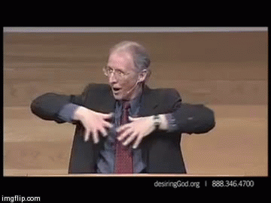
Some do not know what to do with their hands.
Others remain immobile in the same place.
Make gestures that make some sense

Slide 62
The movements must be natural and not as artificial as some presenters do.
Be careful not to strengthen some mimics or imitations that will later be difficult for you to put aside.

Slide 63
Some basic gestures

Slide 64
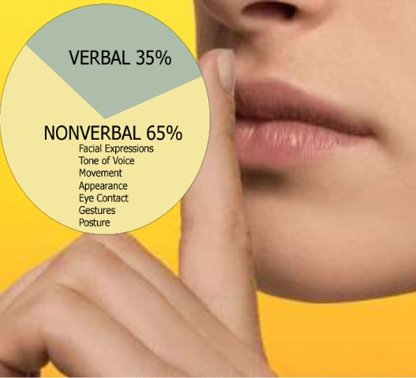

Slide 69
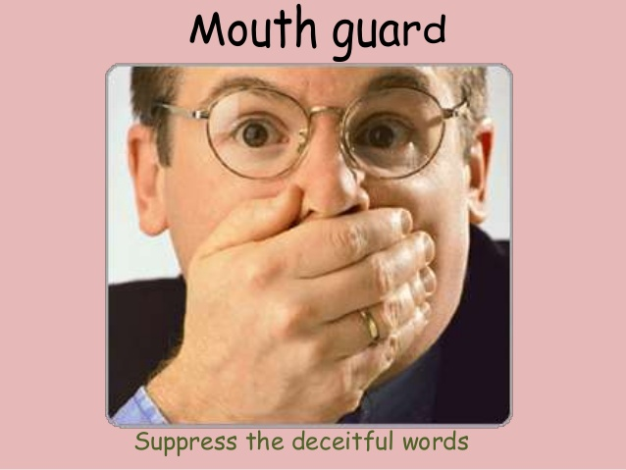

Slide 72
"When they speak, that each word is complete and well modulated, that each phrase is clear and distinct until the final word. Many people, at the end of a sentence, diminish the tone of the voice, speaking so interchangeably that the force of thought is destroyed.

Slide 73
The words that deserve to be spoken deserve to be said in a clear and distinct voice, with emphasis and expression. But never choose words that give the impression that you are wise. The greater your simplicity, the better your words will be understood. " Testimonies for the Church 6, p. 383. (EC 74)

