Slide 1
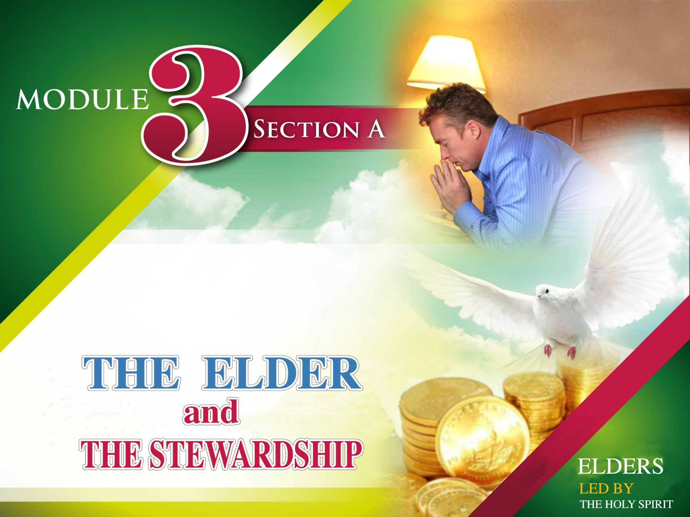

Slide 2

“Even though I was once a blasphemer and a persecutor and a violent man, I was shown mercy because I acted in ignorance and unbelief.”.
1 Timoteo 4:13.
Let's see the role of the elder in regards to the department of stewardship, his duties as steward and his role as a leader who must ensure the fidelity of his brothers.

Slide 3
Let's see the role of the elder in regards to the department of stewardship, his duties as steward and his role as a leader who must ensure the fidelity of his brothers.
I. A Good Elder promotes faithful stewardship

Slide 4
He presents the principles of stewardship clearly to the church.
He assumes the responsibility of stewardship in his church without thinking that it is an issue that belongs only to the pastor.
He does not allow wrong interpretations regarding the subject of tithes and offerings.
Organize weeks of stewardship in the church.
Periodically preaches this theme to the congregation.
Is the first who, along with his family, sets an example of fidelity, especially in the return of tithes.

Slide 5
Organize weeks of stewardship in the church.
Periodically preaches this theme to the congregation.
Is the first who, along with his family, sets an example of fidelity, especially in the return of tithes.
He promotes attendance to the trainings on stewardship given by the Conference.
He oversees the counting of tithes and offerings every Saturday.
He carefully watches out for the financial resources that come to the church.

Slide 6
Ellen G. White counsels:
Organize weeks of stewardship in the church.
Periodically preaches this theme to the congregation.
Is the first who, along with his family, sets an example of fidelity, especially in the return of tithes.
“There is great need of instruction concerning the obligations and duties to God, especially in regard to paying an honest tithe.” CS, page 104.1.

Slide 7
“The overseer of the flock of God should faithfully discharge his duty. If he takes the position that because this is not pleasant to him, he will leave it for someone else to do, he is not a faithful worker.” CS, page 104.2.
Organize weeks of stewardship in the church.
Periodically preaches this theme to the congregation.
Is the first who, along with his family, sets an example of fidelity, especially in the return of tithes.

Slide 8
Organize weeks of stewardship in the church.
Periodically preaches this theme to the congregation.
Is the first who, along with his family, sets an example of fidelity, especially in the return of tithes.
“If the pastors show that they are not fitted for their charge, if they fail to set before the church the importance of returning to God His own, if they do not see to it that the officers under them are faithful, and that the tithe is brought in, they are in peril. They are neglecting a matter which involves a blessing or a curse to the church.” CS, page 106.1.

Slide 9
Organize weeks of stewardship in the church.
Periodically preaches this theme to the congregation.
Is the first who, along with his family, sets an example of fidelity, especially in the return of tithes.
“Let the elders and officers of the church follow the direction of the Sacred Word, and urge upon their members the necessity of faithfulness in the payment of pledges, tithes, and offerings.” C.S. Page 106.3

Slide 10
Organize weeks of stewardship in the church.
Periodically preaches this theme to the congregation.
Is the first who, along with his family, sets an example of fidelity, especially in the return of tithes.
A Good Elder instructs the church regarding the return of tithe

Slide 11
Organize weeks of stewardship in the church.
Periodically preaches this theme to the congregation.
Is the first who, along with his family, sets an example of fidelity, especially in the return of tithes.
He does not allow tithes to be used incorrectly.
With his messages and example, he banishes selfishness from his church.
He promotes stewardship for children in his congregation.
He teaches fidelity by precept and by example.

Slide 12
“It is the duty of the elders and officers of the church to instruct the people on this important matter, and to set things in order. As laborers together with God, the officers of the church should be sound upon this plainly revealed question. The ministers themselves should be strict to carry out to the letter the injunctions of God’s word. Those who hold positions of trust in the church should not be negligent, but they should see that the members are faithful in performing this duty…”CS page 106.3
Organize weeks of stewardship in the church.
Periodically preaches this theme to the congregation.
Is the first who, along with his family, sets an example of fidelity, especially in the return of tithes.

Slide 13
Organize weeks of stewardship in the church.
Periodically preaches this theme to the congregation.
Is the first who, along with his family, sets an example of fidelity, especially in the return of tithes.
“Let the church appoint pastors or elders who are devoted to the Lord Jesus, and let these men see that officers are chosen who will attend faithfully to the work of gathering in the tithe”.
CS, page 106.1

Slide 14
Organize weeks of stewardship in the church.
Periodically preaches this theme to the congregation.
Is the first who, along with his family, sets an example of fidelity, especially in the return of tithes.
III. A Good Elder promotes offerings.

Slide 15
The elder will watch over the church to encourage them to bring offerings.
He will teach his church, that true giving, is measured, not by tithes, but by the offerings we bring to the church.
He will teach the difference between: FIDELITY AND DADIVOSITY.
Organize weeks of stewardship in the church.
Periodically preaches this theme to the congregation.
Is the first who, along with his family, sets an example of fidelity, especially in the return of tithes.

Slide 16
We apply fidelity when we return what does not belong to us, the tithes.
Generosity is demonstrated when, of what God leaves with us, we decide, voluntarily, to give offerings for the Lord.
He will explain to the church what the offering system of 60-20-20 consists of, and the Personal Giving Plan.
Organize weeks of stewardship in the church.
Periodically preaches this theme to the congregation.
Is the first who, along with his family, sets an example of fidelity, especially in the return of tithes.

Slide 17
“The offering from the heart that loves, God delights to honor, giving it highest efficiency in service for Him. If we have given our hearts to Jesus, we also shall bring our gifts to Him”. CS, page 198.2
Organize weeks of stewardship in the church.
Periodically preaches this theme to the congregation.
Is the first who, along with his family, sets an example of fidelity, especially in the return of tithes.

Slide 18
Organize weeks of stewardship in the church.
Periodically preaches this theme to the congregation.
Is the first who, along with his family, sets an example of fidelity, especially in the return of tithes.
“Each of you must bring a gift in proportion to the way the Lord your God has blessed you.” Deuteronomy 16:17.

Slide 19
Organize weeks of stewardship in the church.
Periodically preaches this theme to the congregation.
Is the first who, along with his family, sets an example of fidelity, especially in the return of tithes.
IV. A Good Elder warns about the results of faithfulness and unfaithfulness.

Slide 20
1. We MUST fulfill our promises to God.
Organize weeks of stewardship in the church.
Periodically preaches this theme to the congregation.
Is the first who, along with his family, sets an example of fidelity, especially in the return of tithes.
“When you make a vow to God, do not delay to fulfill it. He has no pleasure in fools; fulfill your vow. It is better not to make a vow than to make one and not fulfill it.”
Eclesiastees 5:4,5. NIV

Slide 21
Organize weeks of stewardship in the church.
Periodically preaches this theme to the congregation.
Is the first who, along with his family, sets an example of fidelity, especially in the return of tithes.
“A church is responsible for the pledges of its individual members. If they see that there is a brother who is neglecting to fulfill his vows, they should labor with him kindly but plainly

Slide 22
Organize weeks of stewardship in the church.
Periodically preaches this theme to the congregation.
Is the first who, along with his family, sets an example of fidelity, especially in the return of tithes.
If he is not in circumstances which render it possible for him to pay his vow, and he is a worthy member and has a willing heart, then let the church compassionately help him. Thus they can bridge over the difficulty, and receive a blessing themselves.” CS, page 310.1

Slide 23
“The pledge is not made to man, but to God, and is as a written note given to a neighbor. No legal bond is more binding upon the Christian for the payment of money, than a pledge made to God.” CS, page 315.1
Organize weeks of stewardship in the church.
Periodically preaches this theme to the congregation.
Is the first who, along with his family, sets an example of fidelity, especially in the return of tithes.

Slide 24
2. Unfaithfulness
Brings death.
Organize weeks of stewardship in the church.
Periodically preaches this theme to the congregation.
Is the first who, along with his family, sets an example of fidelity, especially in the return of tithes.
We have the case of Ananias and Sapphira in Acts 5: 1-11.
They forgot that the promise was to God and not to the disciples.
They thought that they could deceive the disciples and in any case look good in front of them, half-fulfilling what they had promised.

Slide 25
Organize weeks of stewardship in the church.
Periodically preaches this theme to the congregation.
Is the first who, along with his family, sets an example of fidelity, especially in the return of tithes.
They thought that quantity was more important than fidelity.
Not only were they prey to selfishness, but they planned to lie and they did.
They wanted to offer half obedience and God does not accept half obedience

Slide 26
Organize weeks of stewardship in the church.
Periodically preaches this theme to the congregation.
Is the first who, along with his family, sets an example of fidelity, especially in the return of tithes.
“When Ananias heard this, he fell down and died. And great fear seized all who heard what had happened.” Acts 5:5.

Slide 27
Organize weeks of stewardship in the church.
Periodically preaches this theme to the congregation.
Is the first who, along with his family, sets an example of fidelity, especially in the return of tithes.
“At that moment she fell down at his feet and died. Then the young men came in and, finding her dead, carried her out and buried her beside her husband.” Acts 5: 10.

Slide 28
3. Faithfulness produces life.
Organize weeks of stewardship in the church.
Periodically preaches this theme to the congregation.
Is the first who, along with his family, sets an example of fidelity, especially in the return of tithes.
We have the case of the Widow of Zarephath. 1 Kings 17:8-24.
*She was not having the best time of her life.
*She was living in a time of crisis when life was in danger due to lack of water and food.

Slide 29
Organize weeks of stewardship in the church.
Periodically preaches this theme to the congregation.
Is the first who, along with his family, sets an example of fidelity, especially in the return of tithes.
She had very little food left in her jar. Vs.12.
The widow was convinced that the only thing that awaited her and her son was death since the little they had was enough for a small meal. Vs. 12.
The drought was in full swing and there was no hope of rain.

Slide 30
She received the invitation to give:
Organize weeks of stewardship in the church.
Periodically preaches this theme to the congregation.
Is the first who, along with his family, sets an example of fidelity, especially in the return of tithes.
•In the first place, the prophet asked for water and this was what was most scarce at the time. Vs. 10.
He asked her to give him bread to eat, when she no longer had flour. Vs. 12.

Slide 31
Organize weeks of stewardship in the church.
Periodically preaches this theme to the congregation.
Is the first who, along with his family, sets an example of fidelity, especially in the return of tithes.
He asked her to make the food and give it to him first. Vs- 13.
Once he ate then she made food for her and her son.
Vs. 13.

Slide 32
She believed the promise by faith:
Organize weeks of stewardship in the church.
Periodically preaches this theme to the congregation.
Is the first who, along with his family, sets an example of fidelity, especially in the return of tithes.
The flour of the jar will not be used lp. Vs. 14.
The oil in the vessel will not decrease. Vs- 14.
Jehovah will send rain to the earth. Vs. 14 lp.

Slide 33
"Then she went and did as Elijah told her ..." Vs. 15.
then proved to be very obedient.
She proved she trusted God fully.
Organize weeks of stewardship in the church.
Periodically preaches this theme to the congregation.
Is the first who, along with his family, sets an example of fidelity, especially in the return of tithes.

Slide 34
She accepted that obedience and faithfulness are above self-interest.
She forgot herself to think of others.
She gave God the first place and then what was left was for her.
Organize weeks of stewardship in the church.
Periodically preaches this theme to the congregation.
Is the first who, along with his family, sets an example of fidelity, especially in the return of tithes.

Slide 35
Her eyes saw the result of obeying without questioning:
Organize weeks of stewardship in the church.
Periodically preaches this theme to the congregation.
Is the first who, along with his family, sets an example of fidelity, especially in the return of tithes.
The jar flour was never empty. Vs. 16.
The oil in the vessel never waned. Vs. 16.
She ate during the whole crisis. Vs. 15.
Her house also ate during all that drought.
Her fidelity benefited her family. Vs. 15.

Slide 36
A final trial awaited her:
Organize weeks of stewardship in the church.
Periodically preaches this theme to the congregation.
Is the first who, along with his family, sets an example of fidelity, especially in the return of tithes.
Her son got sick and died.
1Kings 17:17-18.
“Some time later the son of the woman who owned the house became ill. He grew worse and worse, and finally stopped breathing.”. 1Kings 17:17 NIV

Slide 37
Organize weeks of stewardship in the church.
Periodically preaches this theme to the congregation.
Is the first who, along with his family, sets an example of fidelity, especially in the return of tithes.
God, as a reward for her faithfulness and obedience, resurrected her son through the prophet Elijah.
1 Kings17:19-24.

Slide 38
“Give me your son,” Elijah replied. He took him from her arms, carried him to the upper room where he was staying, and laid him on his bed.” Vs.19.
Organize weeks of stewardship in the church.
Periodically preaches this theme to the congregation.
Is the first who, along with his family, sets an example of fidelity, especially in the return of tithes.

Slide 39
Organize weeks of stewardship in the church.
Periodically preaches this theme to the congregation.
Is the first who, along with his family, sets an example of fidelity, especially in the return of tithes.
“Then he stretched himself out on the boy three times and cried out to the Lord, “Lord my God, let this boy’s life return to him!” Vs. 21

Slide 40
Organize weeks of stewardship in the church.
Periodically preaches this theme to the congregation.
Is the first who, along with his family, sets an example of fidelity, especially in the return of tithes.
“22. The Lord heard Elijah’s cry, and the boy’s life returned to him, and he lived.
23. Elijah picked up the child and carried him down from the room into the house. He gave him to his mother and said, “Look, your son is alive!” Vs. 22, 23.

Slide 41
“Then the woman said to Elijah, “Now I know that you are a man of God and that the word of the Lord from your mouth is the truth.” Vs. 24
Organize weeks of stewardship in the church.
Periodically preaches this theme to the congregation.
Is the first who, along with his family, sets an example of fidelity, especially in the return of tithes.

Slide 42
In these two stories is summarized the difference between humbly obeying God and wanting to do our own will.
The disobedience of Ananias and Sapphira brought death.
The humble obedience of the widow of Zarephath, brought life.
Organize weeks of stewardship in the church.
Periodically preaches this theme to the congregation.
Is the first who, along with his family, sets an example of fidelity, especially in the return of tithes.

Slide 43
Organize weeks of stewardship in the church.
Periodically preaches this theme to the congregation.
Is the first who, along with his family, sets an example of fidelity, especially in the return of tithes.
Reafirming our Study

Slide 44
Write down four ways an elder can promote Stewardship.
What should the elder teach the church regarding tithes?
In the promotion of the offerings: What should an elder teach?
The great lesson in the history of Ananias and Sapphira.
The great lesson in the story of the widow of Zarephath and Elijah.
Organize weeks of stewardship in the church.
Periodically preaches this theme to the congregation.
Is the first who, along with his family, sets an example of fidelity, especially in the return of tithes.

Slide 45
“Those who hold positions of trust in the church should not be negligent, but they should see that the members are faithful in performing this duty.... Let the elders and officers of the church follow the direction of the Sacred Word, and urge upon their members the necessity of faithfulness in the payment of pledges, tithes, and offerings.—The Review and Herald, December 17, 1889.” CS page 106.3
Organize weeks of stewardship in the church.
Periodically preaches this theme to the congregation.
Is the first who, along with his family, sets an example of fidelity, especially in the return of tithes.

Slide 46
Organize weeks of stewardship in the church.
Periodically preaches this theme to the congregation.
Is the first who, along with his family, sets an example of fidelity, especially in the return of tithes.
He ensures that new members know, correctly, the subject of tithing.
Guides the church about how the organization uses tithes.
Teaches the church the biblical principles of tithing.

