Slide 1
Jewel Basics
Rachel Linares

Slide 2
Step by Step through the month
Jewel Basics:
Entering Offerings
Adventist Giving
Write Checks
Journal Entries
Remittances
Budget Allocations
Bank Reconciliations
Backing up your database
Additional topics:
NSF Checks
Voiding a check
Editing or adjusting entries
CURF transactions
Reports
Editing accounts/names
Jewel Settings

Slide 3
Entering Offerings
Follow the envelope
If the donor has not filled out the envelope correctly, do not make changes yourself, discuss it with the donor
If the amount in the envelope is incorrect, discuss it with the donor

Slide 4
Adventist Giving
Two methods of importing:
Log in – retrieves the latest offering only
Import from a file – will allow you to import any file in the current period
Notes: Importing duplicate offerings is a common mistake. The new version of Jewel will warn you if you are about to do this. Don’t ignore it! If you do import duplicates, call Jewel support for assistance.

Slide 5
Adventist Giving
How to Import From a File
Step 1: Download file from the Adventist Giving website ( PDF recommended, see example on next slide)
Step 2: Click on Start New Offering and then Import from File
Step 3: Map Accounts
Step 4: Review and click OK.

Slide 6
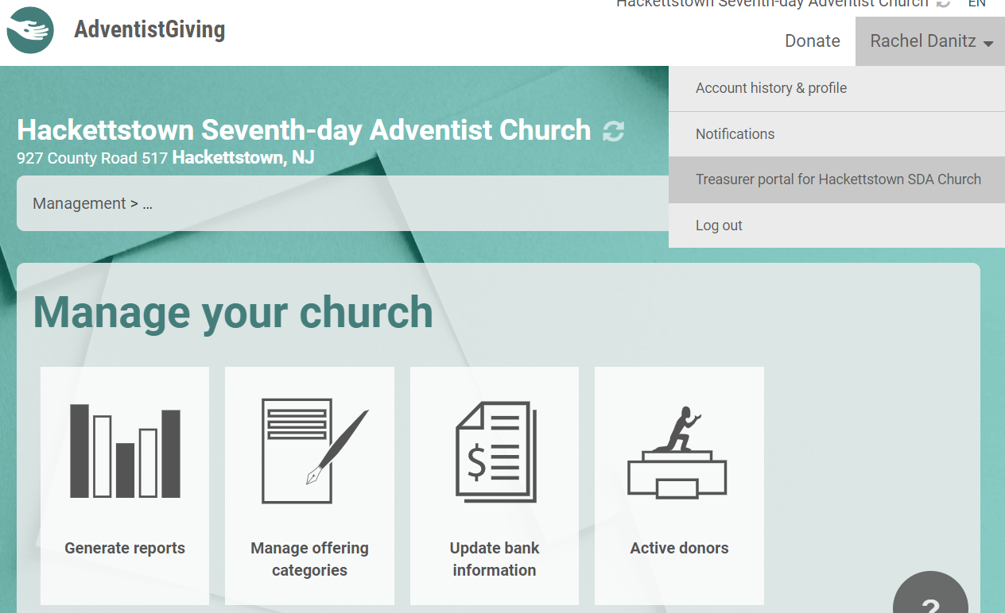
HINT: If you don’t choose a location to save your AG report, it will most likely be found in your downloads folder.

Slide 7
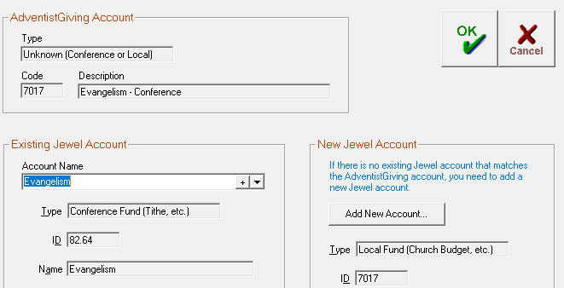
Adventist Giving Mapping Errors
Notes:
Choose an account to map to. If the OK button doesn’t work, click cancel, and continue mapping all the accounts. You will have to continue clicking cancel after mapping the accounts. You will not see them appear under the Jewel column, so after they are all “mappe”, cancel the offering, and import again.

Slide 8
Writing Checks
HINT: If you do not want to print your checks from Jewel, you can turn this feature off by clicking on the MAINTENANCE menu and clicking PROPERTIES then GENERAL
When to use the “write a check” button:
When recording any expense that was paid using a check
When recording online payments

Slide 9
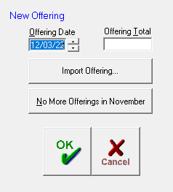
Remittances
After the last offering has been entered, Jewel will ask if you are finished with offerings for the month
If it does not automatically do this, you can click on “No more offerings” on the START NEW OFFERING window

Slide 10
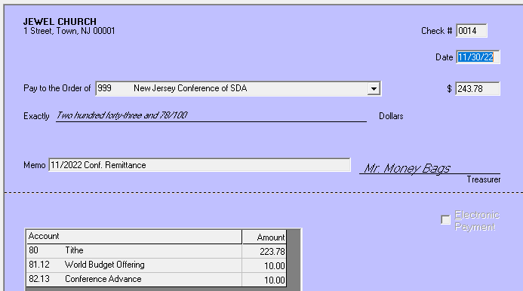
Make sure you are paying your remittance based on the amount generated on the check in Jewel!
Notes:
Remittance checks should be paid based upon the automatically generated remittance from Jewel. Sometimes this number will be different from the contributions report, because it includes the entire balance of the conference accounts in Jewel.
This amount may include adjustments, offerings that were added from a

Slide 11
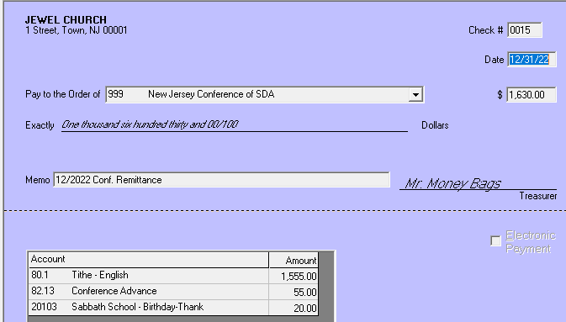
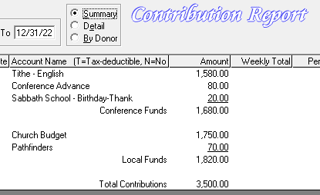
Example of when an adjustment changes the remittance:
A Returned Check for $50
Previous Adjustment= (-50)
New Donations = $1680
Amount Owed to Conference = $1630
(1680-50=1630)
Notes:
Do this only to change the check number or select “electronic payment”.
This is a common mistake that treasurers will make, forgetting to change the check number on the remittance.

Slide 12
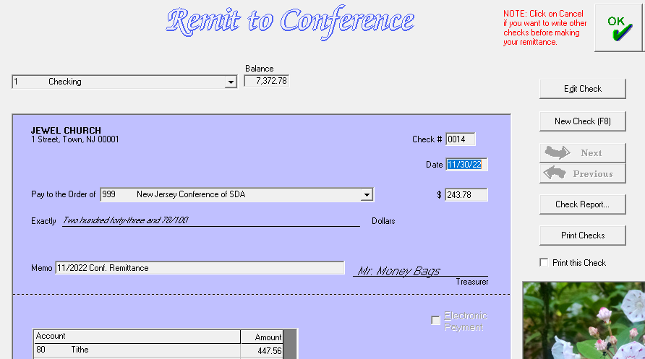
Edit the remittance check BEFORE you save it by clicking on the “EDIT” button
Notes:
Do this only to change the check number or select “electronic payment”.
This is a common mistake that treasurers will make, forgetting to change the check number on the remittance.

Slide 13
Journal Entries
Use a General Journal Entry when:
Recording bank fees and interest
Recording an evangelism check from the conference
Recording a deposit from your CURF account
Purchase Refunds
Any Deposit that is not an offering

Slide 14
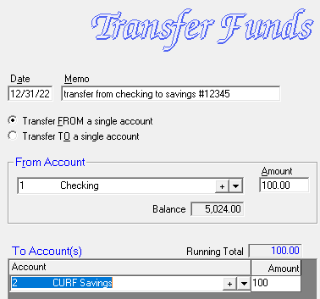
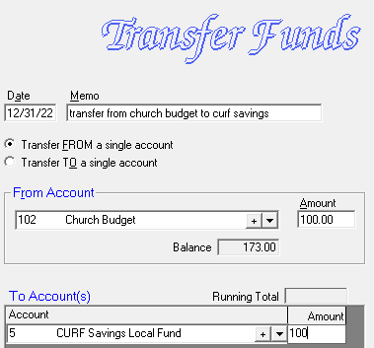
CURF/Savings Entries
Method 1: Transfers
Notes:
Use this method if you are doing an electronic bank transfer

Slide 15
CURF/Savings Entries
Method 1: Transfers
After Step 1
After Step 2
Notes:
Use this method if you are doing an electronic bank transfer

Slide 16
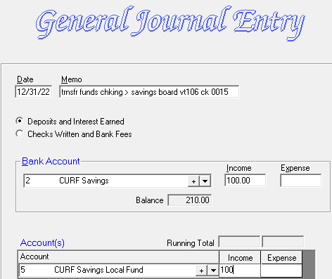
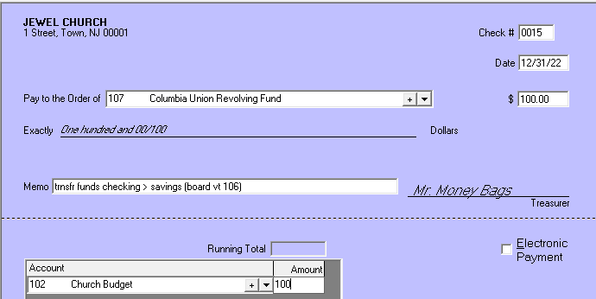
CURF/Savings Entries
Method 2: Check and Journal entry
Notes:
Use this method if you are sending a check to CURF.

Slide 17
Budget Allocations
DECIDE WITH YOUR BOARD…
Do you want to put a certain amount towards each department, but you don’t have the money yet? Use the budget allocations.
Not sure how much your church can afford to allocate for each ministry? Create budget allocations using a percentage instead of a dollar amount.
Do you have money saved in the church budget that can be allocated all at once? Use a “transfer funds” entry to move the money into the line items one time.
Notes:
Do they want to put a certain amount towards each department, but you don’t have the money yet? Use the budget allocations to transfer a little bit of the budget every month. Just take your total budget and divide by 12 to see how much you need to transfer monthly

Slide 18
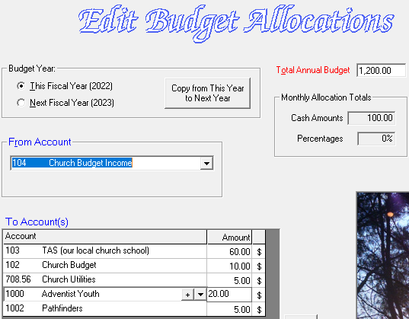
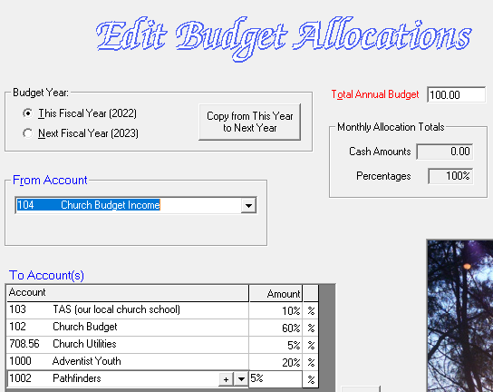
Budget Allocations
Cash amounts:
Percentage:
NOTE: This feature will transfer the full balance of the “transfer from” account every time.
Notes:
This is an optional feature than can help you allocate money from one account (usually church budget) to pay your regular expenses and budget for departments needs
Your church board should discuss and decide on a budget. The treasurer does not decide the budget
Budget allocations can be customized to fit your church by using a monthly dollar amount, a percentage amount, or a yearly amount for each account in your budget
If you want to make allocations for the whole year, use the transfer funds option to make a one-time transfer
If you want to transfer the balance of church budget income for the month, create an income account so that only the future income is affected instead of the full balance of the CB account.

Slide 19
Board Reports: Bank Recs
This is how we find out if the bank and Jewel match:
Start with your Bank balance
Add the deposits from Jewel that did not clear the bank yet
Subtract the expenses from Jewel that have not cleared the bank
This number should = your Jewel balance on that date (if you did it right ☺)

Slide 20
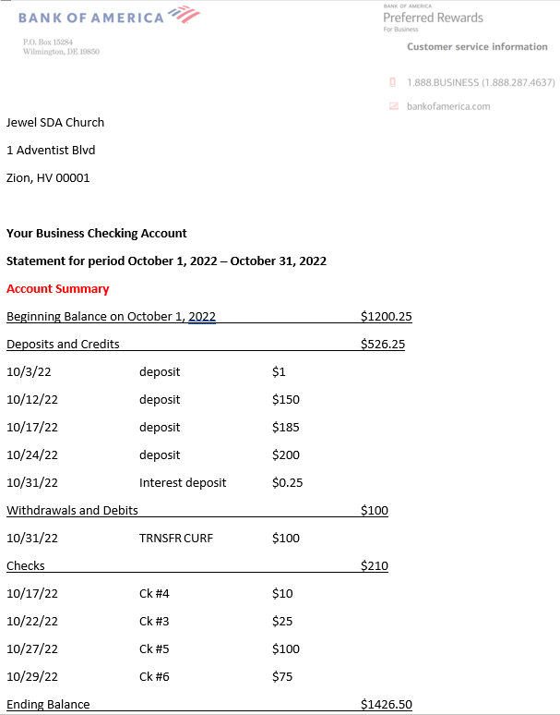
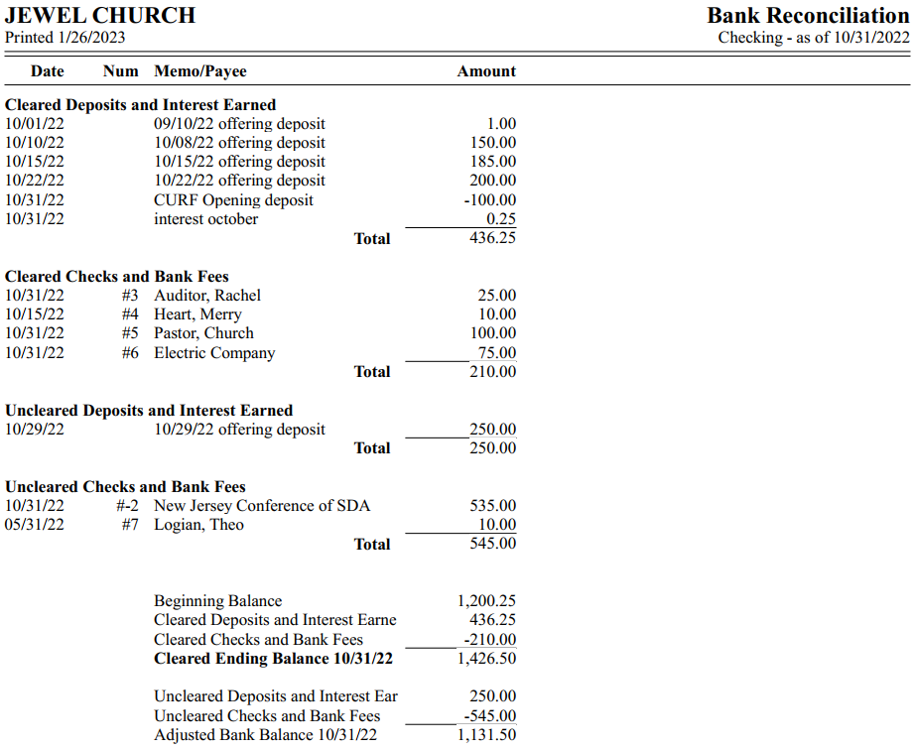
Bank Rec Comparison

Slide 21
Board Reports: Bank Recs
Adjusted Bank Balance = Jewel Ledger Balance

Slide 22
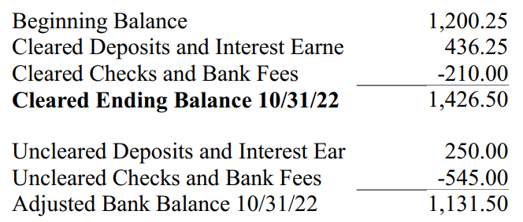
Board Reports: Bank Recs
HINT: Don’t want to print your bank rec report on paper? Turn on “print set up” in the Jewel Properties menu. Now you can print to PDF!

Slide 23
Bank Rec Comparison Steps
Bank reconciliations are being done every month (check the date to see if it is the most recent statement)?
2. Make sure any adjustments on Jewel’s Bank Reconciliation report are also found on the bank statement.
3. The “Cleared Ending Balance” on Jewel’s Bank Reconciliation report should match the “Ending Balance” found on the bank statement.
4. The “Adjusted Bank Balance” on Jewel’s Bank Reconciliation report should match the bank account “Ending Balance” on that month’s Jewel Financial Summary.

Slide 24
Bank Rec Comparison Steps
5. The auditor should be called for assistance if the treasurer or any board member notes one of the following on any Jewel Bank Reconciliation report:
e. An outstanding check older than 3 months f. An uncleared deposit more than 30 days old g. Any odd item that is uncleared, such as an old adjustment h. Any unexplained difference.
6. After you have verified the above items, sign your name and the date at the top of the bank reconciliation report. Call the auditor if you have questions.

Slide 25
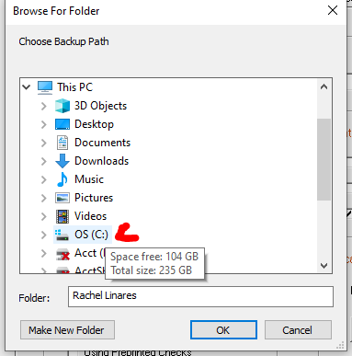
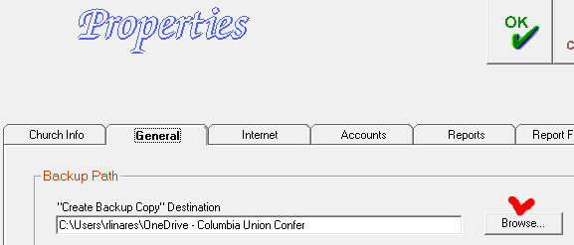
Backing up your database
Back up your database to a flash drive each month so you have it saved somewhere other than the computer
To set up your local backup, Go to Maintenance>Properties>General and where is says “Backup Path”, click the Browse button.
Notes:
Insert the removable backup drive, and you will see it appear on the list of files. Select the removable backup drive as the location and click “Make a new Folder. Name the folder Jewel Backup and Select it. Now click OK to save. Test your back up by clicking on File>Create Backup Copy.

Slide 26
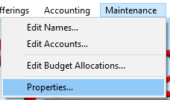
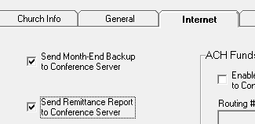
Backing up your database
It is very important to send a backup to the conference server every month. There are two ways to do this:
Notes:
if something happens to your computer, we will be able to restore your Jewel program from the backup.

Slide 27
When in doubt, call us!
Rachel Linares (English)
Email: rlinares@njcsda.org
Phone: 609-802-0860
Yolanda Silva (English and Spanish)
Email: ysilva@njcsda.org
Phone: 609-802-0864

