Slide 1
New Jersey Conference CHURCH PLANTING
PROCESS

Slide 2
1. A lay person or pastor has the conviction to plant a church.
A. If it is a lay person, he or she should express that desire to their local pastor.
B. The lay person, along with his or her pastor, should contact the NJ Conference Evangelism Department and set up a time to meet with the evangelism director to share their vision.
C. The lay person or pastor will then be assigned a coach or VLP and given the Doc. Guidelines to Church Planting. The coach or VLP will start meeting with the person to help them clarify their vision (for example, where to plant, what people group, why they want to plant, etc)

Slide 3
Sharing The Vision With Local Church Leaders
D. Once the vision has been clarified, the lay person should talk with their pastor about sharing the vision with their local church board.
The purpose of sharing with the local church board is to give them the opportunity to take on the project and become the mother church.
(You may want to meet with the elders first and get them on board).
The church board will probably need 2-3 meetings to discuss and pray about this. The church board should then take a vote on sponsoring the church planting project and becoming the mother church. If they feel it is necessary to bring this to a church business session, that is fine.

Slide 4
Mother Church Voted to Sponsor
E. Once the mother church has voted to sponsor the project, the lay person and pastor should complete the church planting request form and submit it to the New Jersey Conference Evangelism Department for approval of the project from ADCOM.
F. Once the church planting request has been approved by ADCOM, the church plant leader should begin the task of forming a core team/leadership team.
Core team members can be chosen from the mother church in consultation with the pastor and/or church board.

Slide 5
Core Team Members
There may be members from other area churches who share the same vision who could be potential core team members. Out of courtesy, the church plant leader should first talk with the pastor of that church before recruiting any of his/her members. Gain the pastor’s support and let him know what you are doing.
G. Once a core team is formed, they should plan to meet together once a week for 6-12 months, preferably in someone’s home.

Slide 6
During These Meetings - Study
During these meetings they should read together:
The book of Acts in the Bible and “Steps to Christ”
Begin formulating plans and a strategy.
During this time, the core team members will continue to attend Sabbath services at their home church. Sabbath services for the church plant should not be launched until after the 6-12 month incubation period.
This ensures a core team that is well prepared, connected, and on the same page. Do not rush this.
During the incubation period, the group should begin ministries and outreach to the target area or target group their church plant is trying to reach.

Slide 7
1st Sabbath Program in the Community
H. When the time is right, begin Sabbath services.
Plan regular outreach activities and conduct evangelistic meetings every year. At this point, the church plant should choose a treasurer who will be responsible for collecting tithes and offerings and giving it to the treasurer of the mother church. Tithes and offerings will still run through the mother church until the church plant becomes an established
The church plant should have access to their offerings through the mother church. If the church plant prefers to have their own bank account, they can work this out in consultation with the mother church.

Slide 8
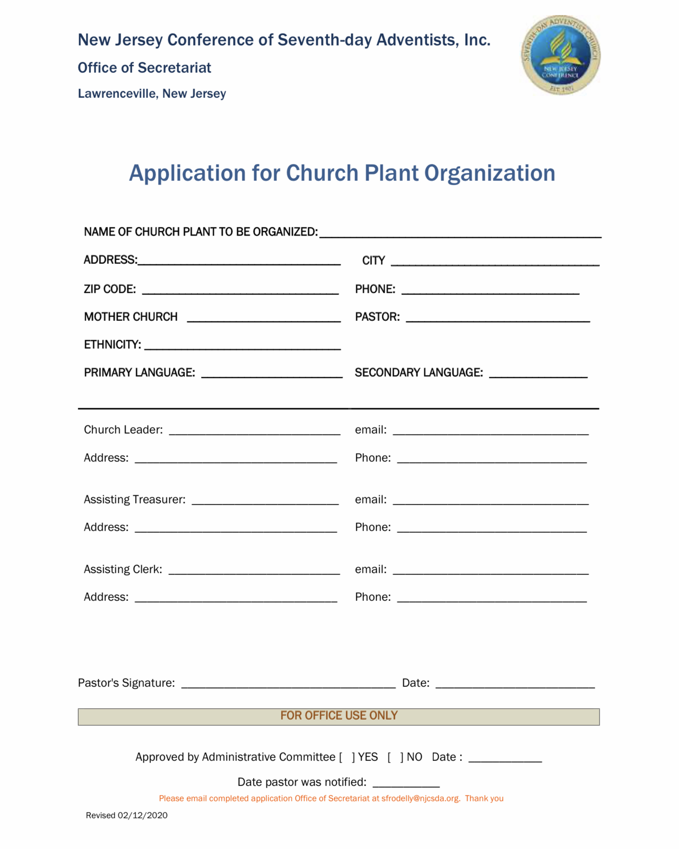

Slide 9
